Slide 1
CSC 439 Sprint Week 3
Jacob Moore, Zack Sprague, James Craig, Chris Wells, Joshua McGuire, Reed Inderwiesche

Slide 2
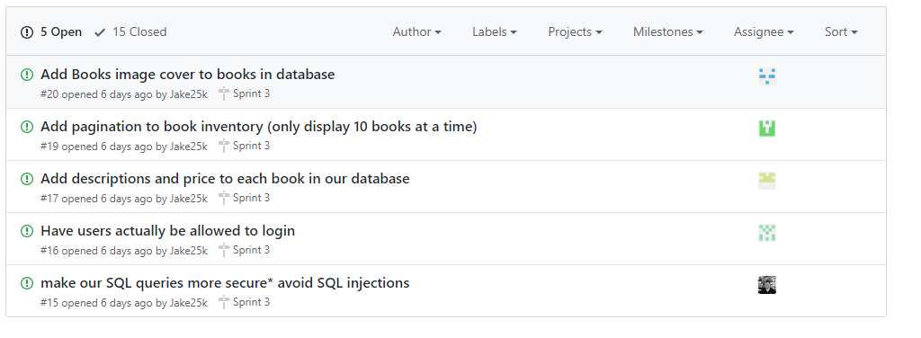
Issues from this week

Slide 3
Team Lead/Developer: James Craig
Task: Create pagination for the Book Inventory page
Issues:
Running from a localhost dataserver vs. live server
Testing:
Test as I implemented (whitebox)

Slide 4
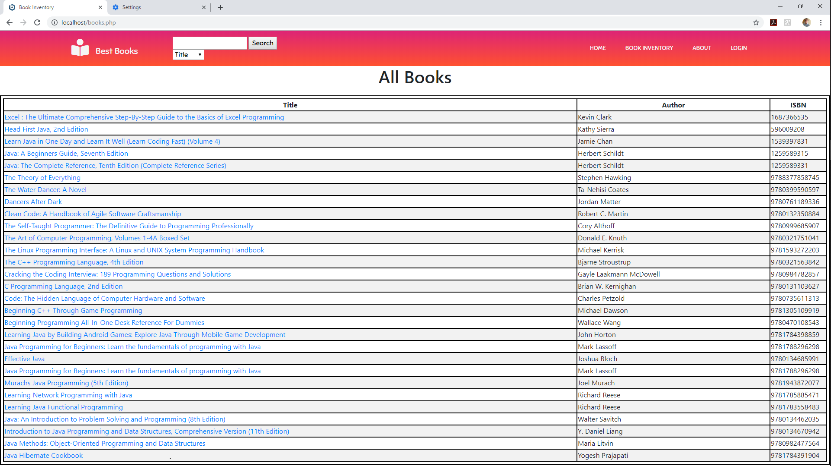
Last Week

Slide 5
This Week
$display = 10;
if (isset($_GET['p']) && is_numeric($_GET['p'])){
$pages = $_GET['p'];
}else{
$db_con = pg_connect("host=ec2-54-235-100-99.compute-1.amazonaws.com port=5432 dbname=db8u3gdkjq4l6i user=oihnrigiktbsug password=03f8fa546db912cfc133c1faa898ef14cd26324691f4ba13ee09d89db73c9e8f");
$query = pg_query($db_con, "SELECT COUNT(*) from books");
$row = pg_fetch_array($query, NULL, PGSQL_NUM);
$records = $row[0];
if ($records > $display){
$pages = ceil($records/$display);
}else{
$pages = 1;
}
}
if(isset($_GET['s']) && is_numeric($_GET['s'])){
$start = $_GET['s'];
}else{
$start = 0;
}
if($pages > 1){
echo '<br /><p>';
$current_page = ($start/$display) + 1;
if($current_page != 1){
echo '<a href="books.php?s=' . ($start - $display) . '&p=' . $pages . '"><<</a> ';
}
for ($i = 1; $i <= $pages; $i++){
if($i != $current_page){
echo '<a href="books.php?s=' . (($display * ($i-1))) . '&p=' . $pages . '">' . $i . '</a> ';
} else {
$i . ' ';
}
}
if($current_page != $pages) {
echo '<a href="books.php?s=' . ($start + $display) . '&p=' . $pages . '">>></a> ';
}
echo '</p>';
}

Slide 6
Build Manager: Jacob Moore
Tasks:
Find a way to run our PHP application locally to start PHP Unit testing
Create dynamic linking so each book has its own page with all its information.
Unit Testing

Slide 7
Build Manager: Jacob Moore
Solutions:
Find a way to run our PHP application locally to start PHP Unit testing
Found a program called Bitnami MAPP that creates a local apache server and postgres server so we can run application locally on our own machines. This offers the ability to run application locally and perform all the unit testing we need. (Also saves us from commiting a million times like we have been doing)

Slide 8
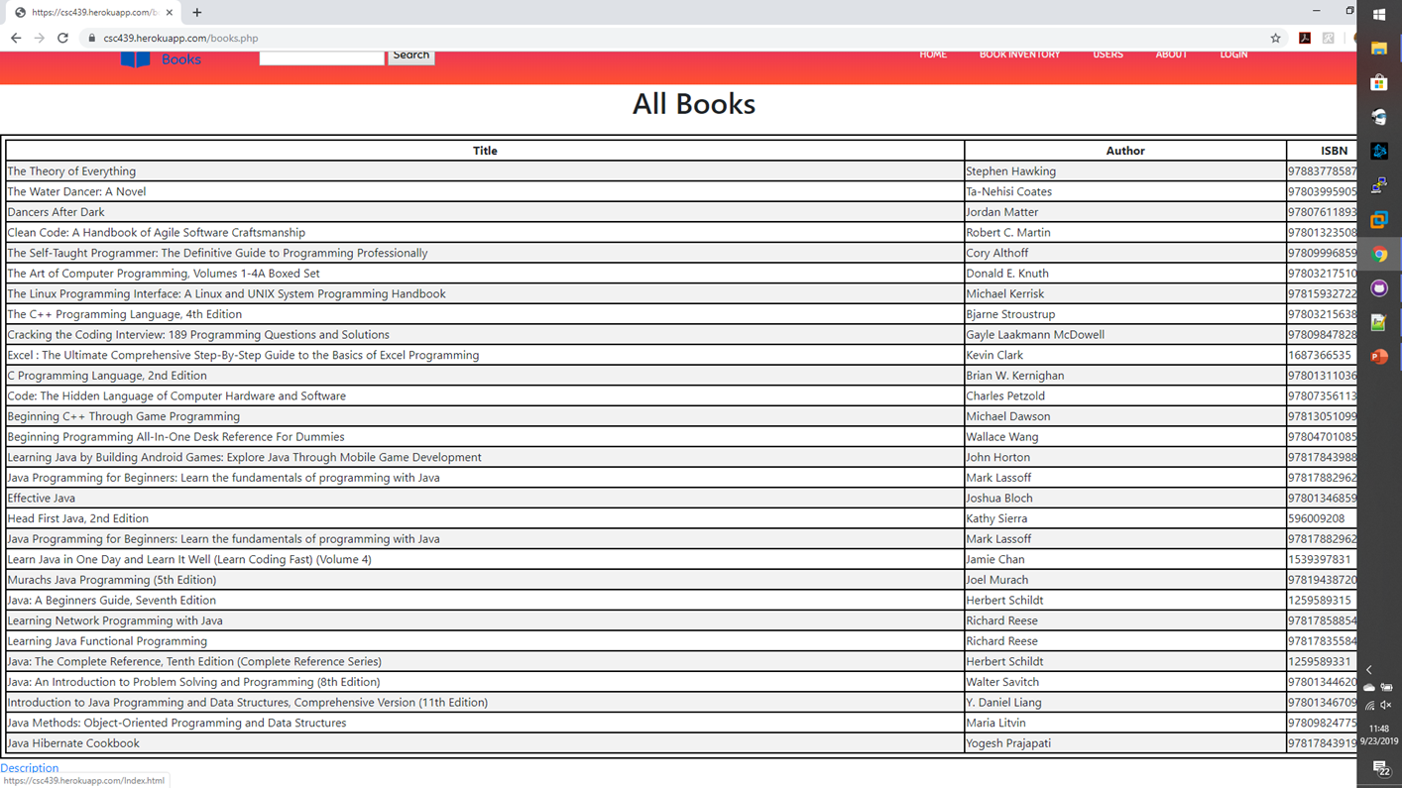
Build Manager: Jacob Moore

Slide 9
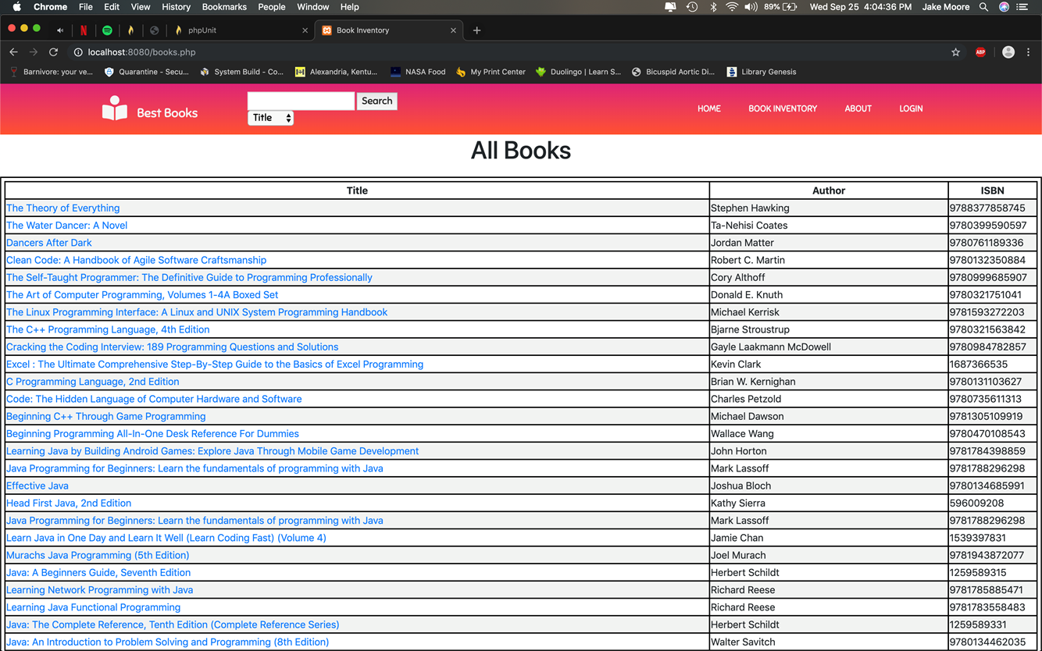
Build Manager: Jacob Moore

Slide 10
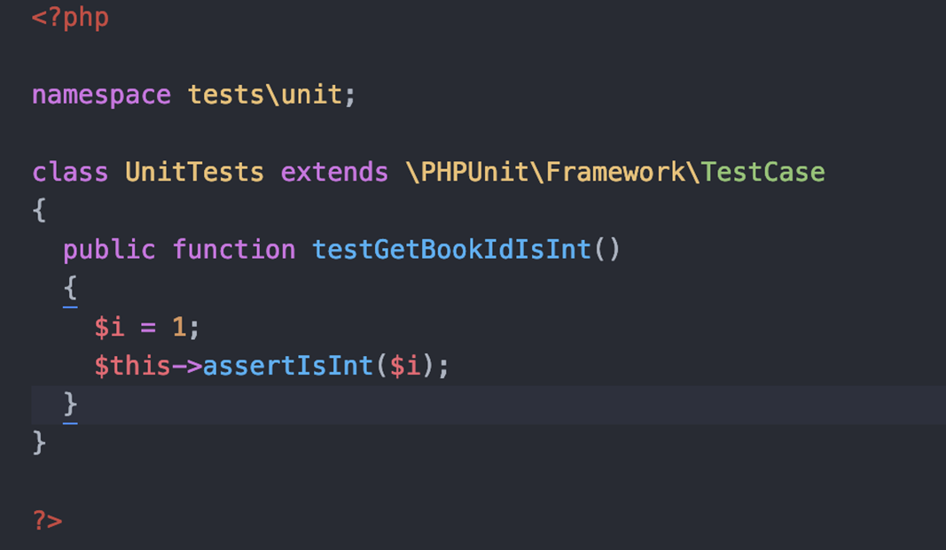
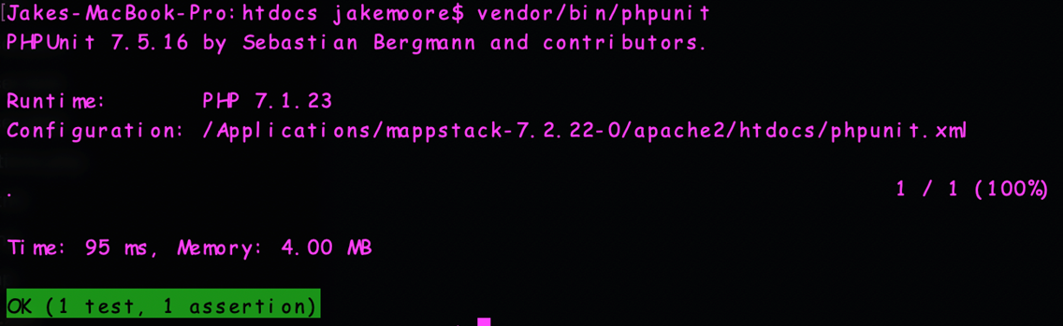
Build Manager: Jacob Moore
Testing:

Slide 11
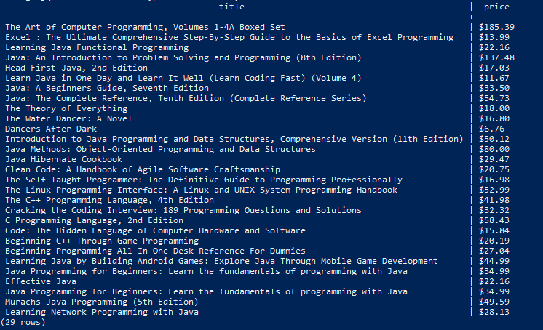
Tester/Developer: Josh McGuire
Updating the SQL database to include both a price and a description of all books.
Used command UPDATE books SET column = value WHERE condition;.
For example UPDATE books SET price = ‘$20’ WHERE book_id=2;

Slide 12
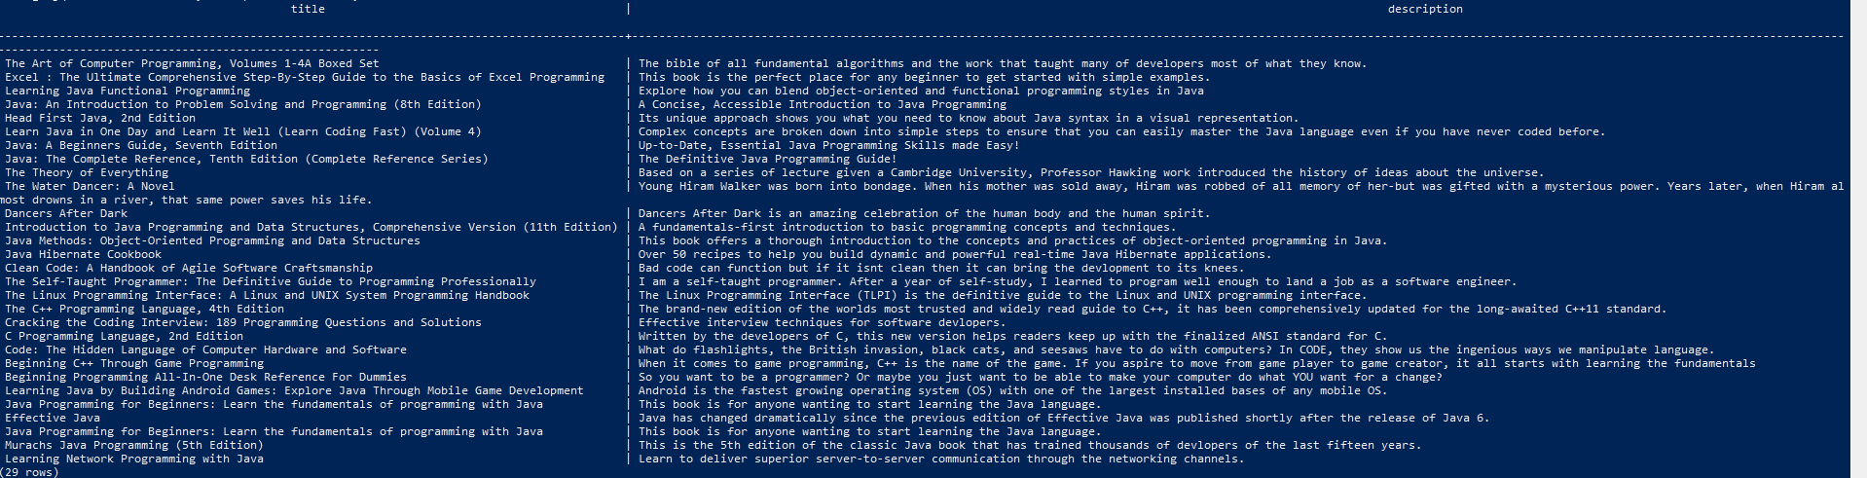
Tester/Developer: Josh McGuire

Slide 13
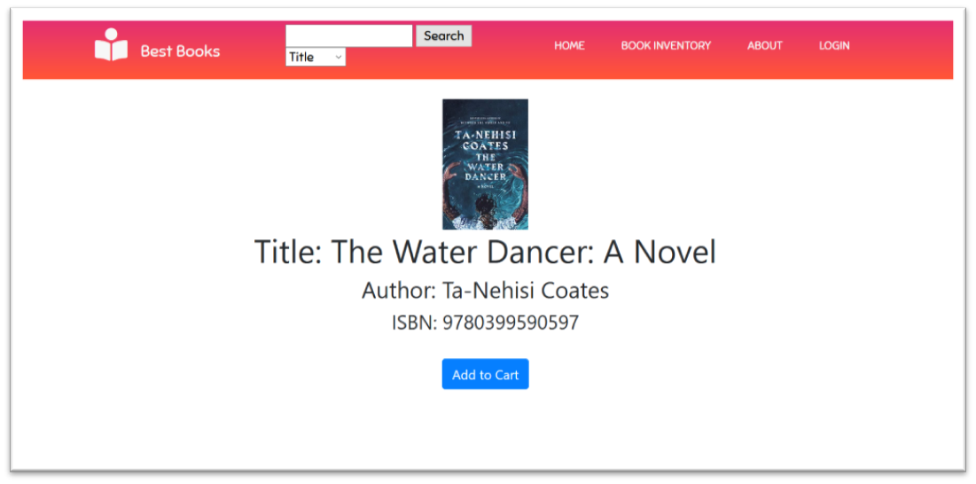
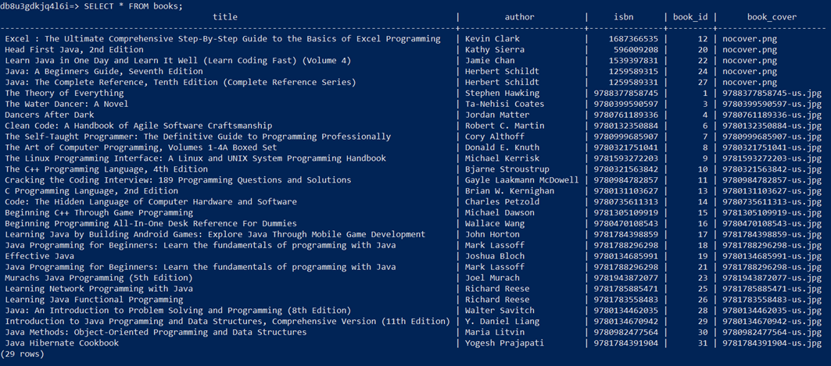
Tester/Developer: Reed Inderwiesche
* upload book cover image for books that do not have a cover to github repo
* update the book table to set the default book value to 'nocover.png'
ALTER TABLE books ALTER COLUMN book_img_url SET DEFAULT 'nocover.png';
UPDATE books SET book_img_url = 'nocover.png';
* wrote a book cover downloader script that gets images from abebooks.com
* the books that have a cover now have the filename of the book's image
UPDATE books SET book_img_url = isbn || '-us.jpg' WHERE isbn > 9780000000000;
* downloaded book covers for all books with a 978- isbn number

Slide 14


Slide 15
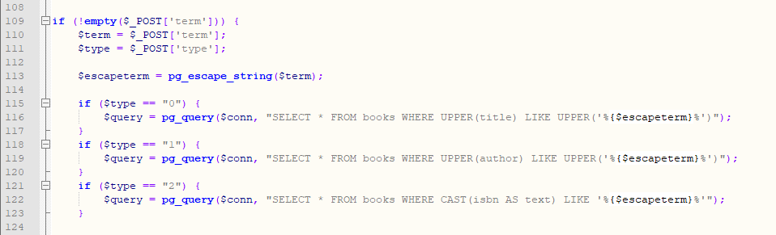
Configuration Manager/Developer: Chris Wells
Task: Modify SQL Queries to Eliminate the Possibility of SQL Injection

Slide 16
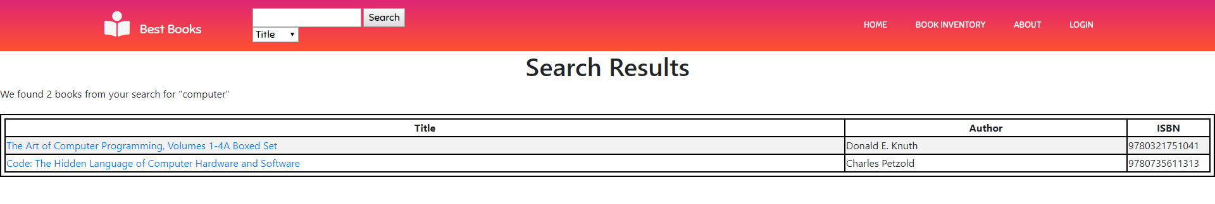
Configuration Manager/Developer: Chris Wells
Task: Add Text Showing a Summary of Search Results

Slide 17
SCM Manager: Zach Sprague
Tasks: 1. Add a create new user link on the login form
2. Implemented the login form for users to create accounts if not already signed up
3. Once the user has an account, they can then login with their username and password.
4. For next sprint, the login button needs to switch to logout once a user is logged in. Also to make error messages look more professional.
5. Need to implement password hashing. PostgreSQL uses pg_crypto for this.

Slide 18
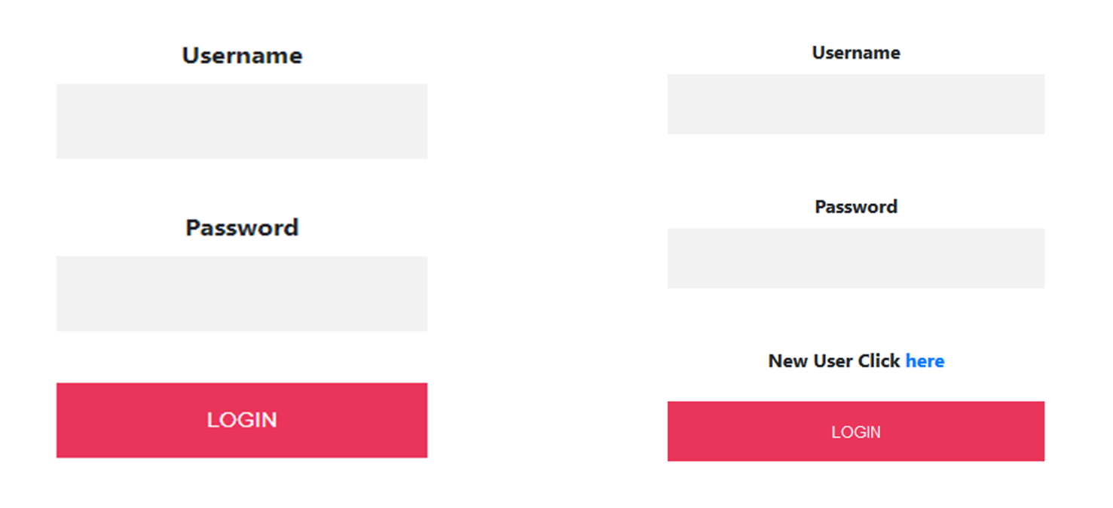
https://github.com/Jake25k/CSC439/commit/936dd8c58106aa56d24f16705420f8a74779a960

Slide 19
